Slide 1
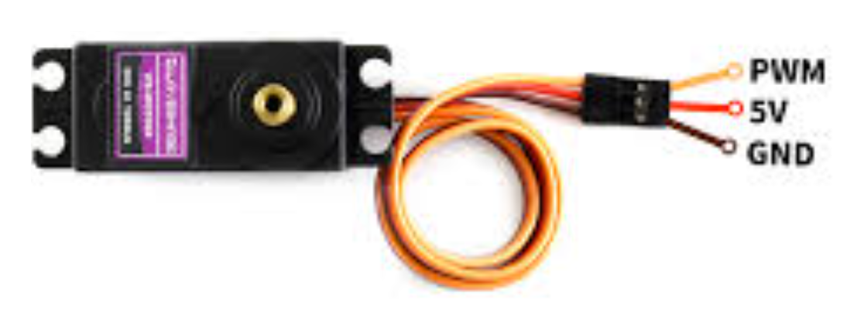
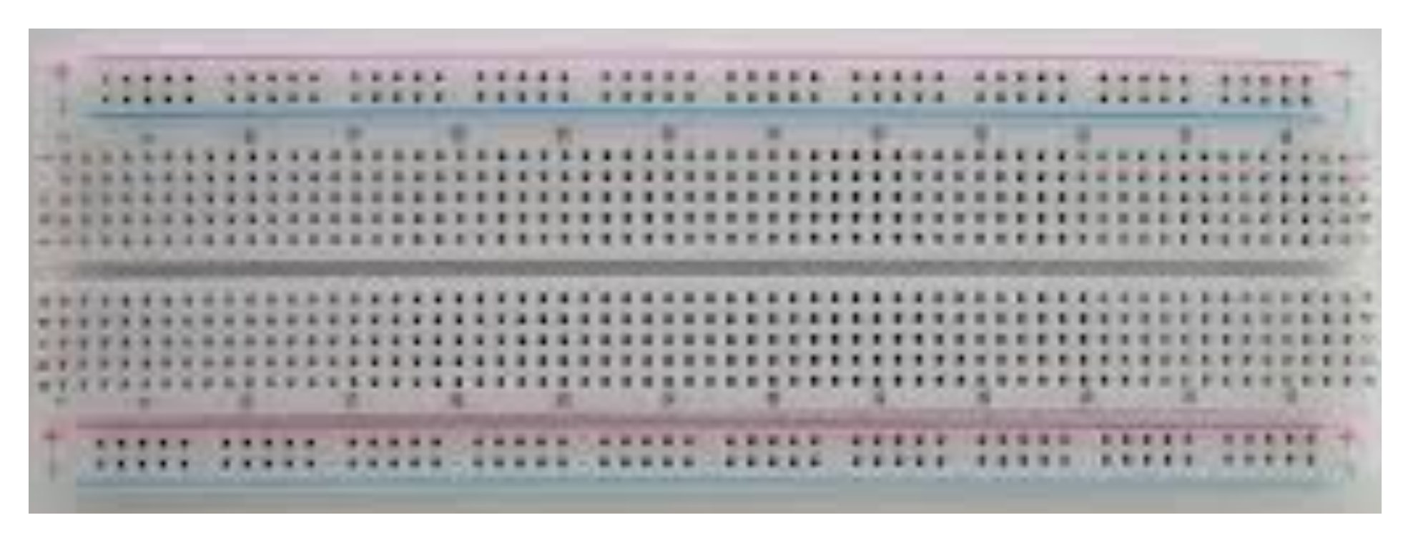
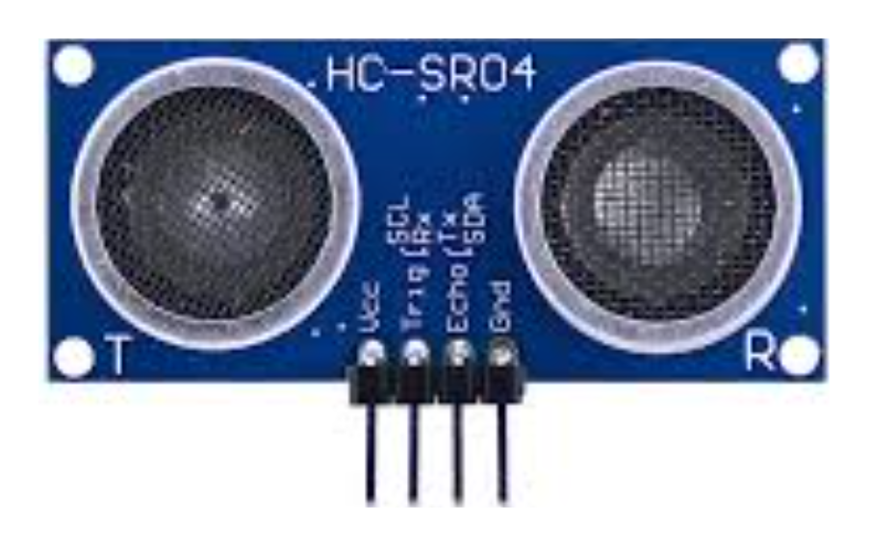
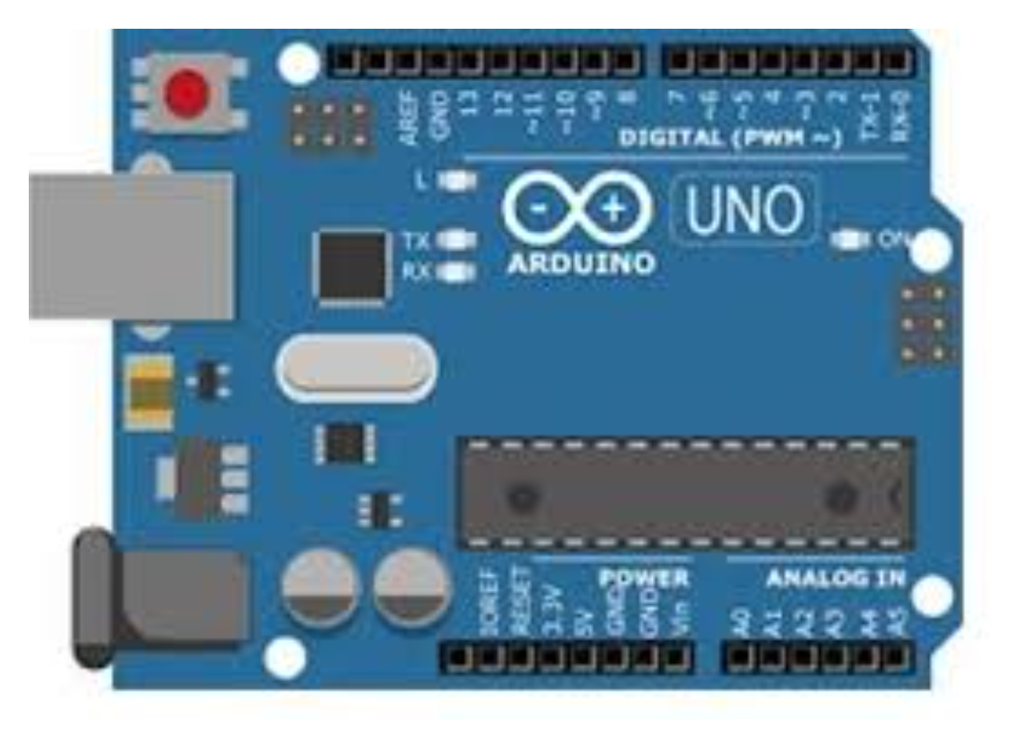
Servo Motor – Pin 12
Sonar Trig – Pin 10
Sonar Echo – Pin 11
GND
+5V
Connected to Laptop
by one USB Cable

